Slide 6
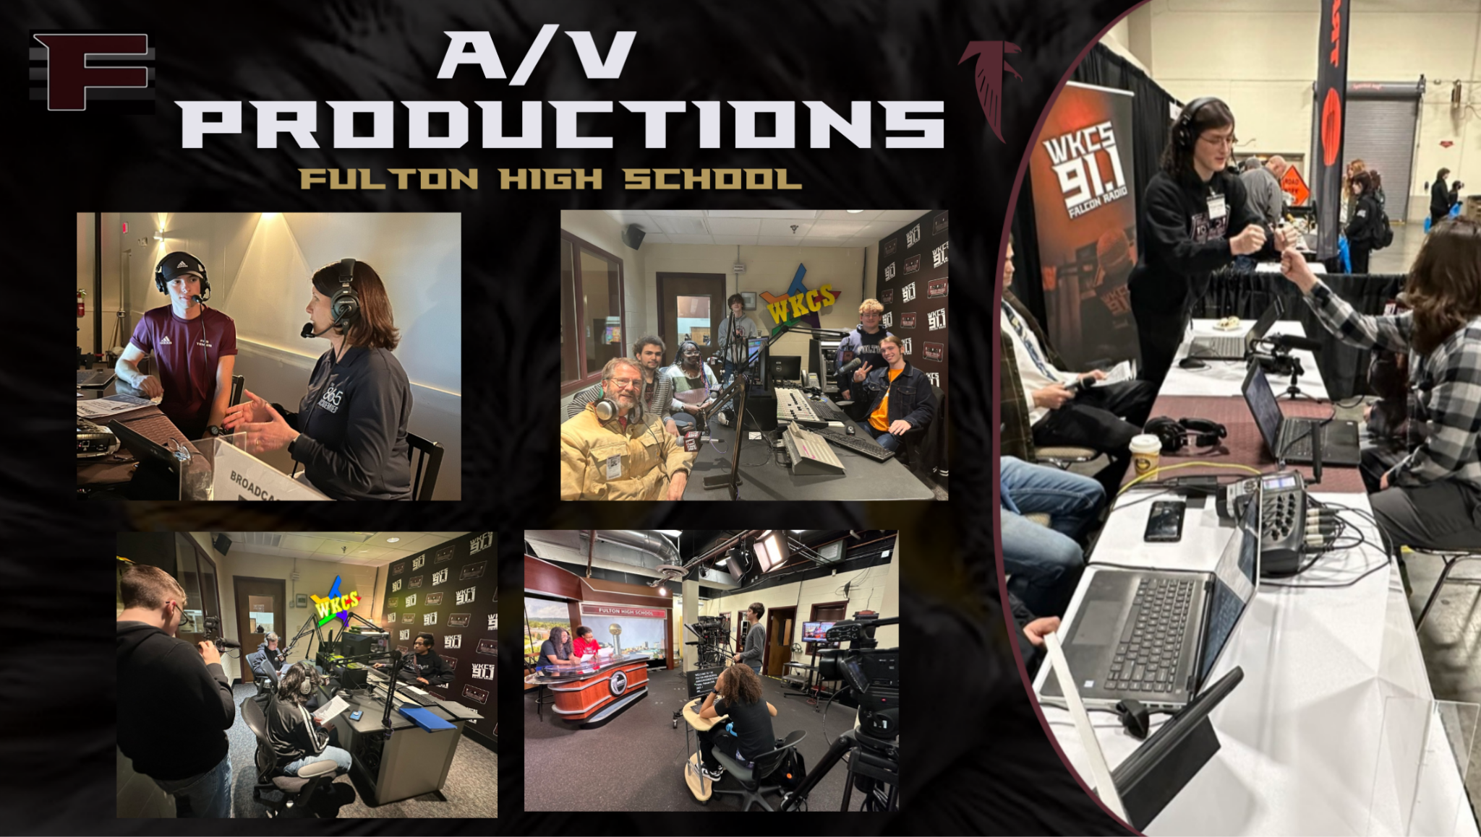

Slide 14
CONTACT INFORMATION
Seth Smith: Executive Principal
seth.smith@knoxschools.org
Hali Boland: Communications Principal
hali.boland@knoxschools.org
Justin Long: Magnet Co-Facilitator
justin.long@knoxschools.org
Buzz McNish: Magnet Co-Facilitator
buzz.mcnish@knoxschools.org

Slide 15
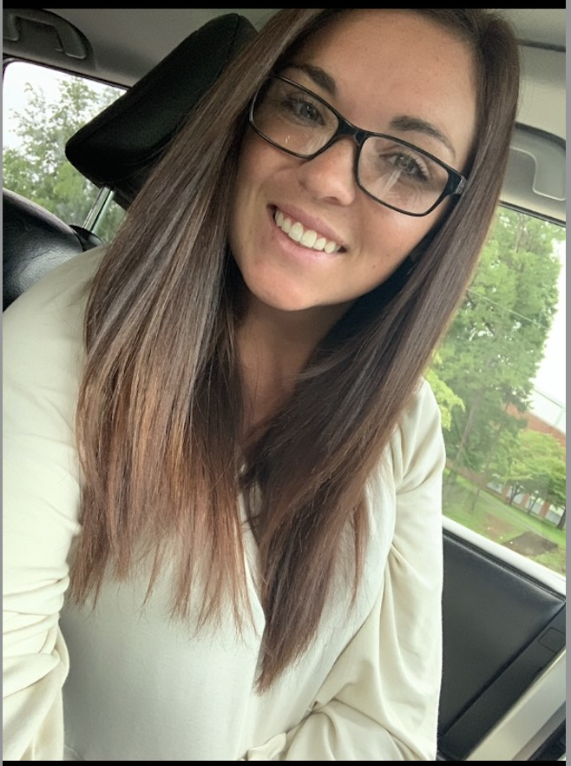
Contact Information
Timothy Childers
FulCom Principal
865-594-1240
timothy.childers@knoxschools.org
Kim Kelly
FulCom Counselor
865-594-1240
kim.kelly@knoxschools.org
Larry Headrick
Magnet Facilitator
865-594-1240 larry.headrick@knoxschools.org
Summer Roark
Magnet Facilitator
865-594-1240 summer.roark@knoxschools.org

